Slide 1


Sara Cavaco
October, 15 th, 2023

Slide 2

Outline
Executive Summary
Introduction
Methodology
Results
Conclusion
Appendix

Slide 3
Executive Summary
Summary of methodologies
Data Collection
Data Wrangling
EDA with data visualization
EDA with SQL
Building an interactive map with Folium
Building a Dashboard with Ploty Dash
Predictive analysis (classification)
Summary of all results
EDA Results
Interactive analytics
Predictive analysis

Slide 4
Introduction
Project background and context
SpaceX advertises Falcon 9 rocket launches on its website with a cost of 62 million dollars; other providers cost upward of 165 million dollars each, much of the savings is because SpaceX can reuse the first stage.
Problems you want to find answers
Therefore if we can determine if the first stage will land, we can determine the cost of a launch.
predict if the Falcon 9 first stage will land successfully

Slide 5

Section 1

Slide 6
Methodology
Executive Summary
Data collection methodology:
SpaceX Rest API
Web Scrapping from Wikipedia
Perform data wrangling
One Hot Enconding Data fields for machine learning and data cleaning of null values and irrelevant columns
Perform exploratory data analysis (EDA) using visualization and SQL
Perform interactive visual analytics using Folium and Plotly Dash
Perform predictive analysis using classification models
LR, KNN, SVN, DT models have been built and evaluated for a better classification

Slide 7
Data Collection
Data collection
API
Acquired historical launch data from open soured REST API for Space X
Web Scraping
You need to present your data collection process use key phrases and flowcharts
Acquired historical launch data from Wikipedia page ‘List of Falcon 9 Falcon Heavy Launches’
Data Wrangling – Explore data to determine the label for training supervised models

Slide 8
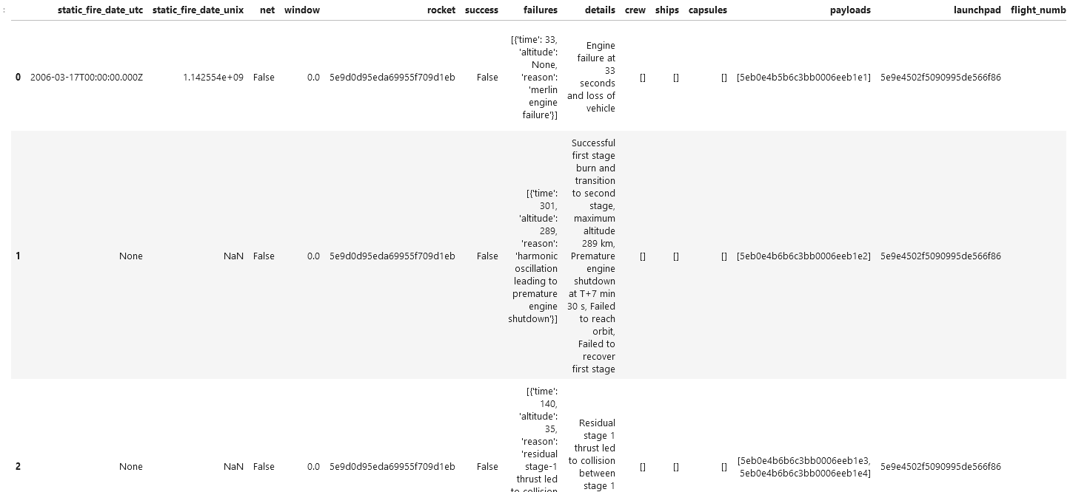
Data Collection – SpaceX API
https://github.com/saracavaco/capstone_work/blob/main/jupyter-labs-spacex-data-collection-api.ipynb
Place your flowchart of SpaceX API calls here

Slide 9
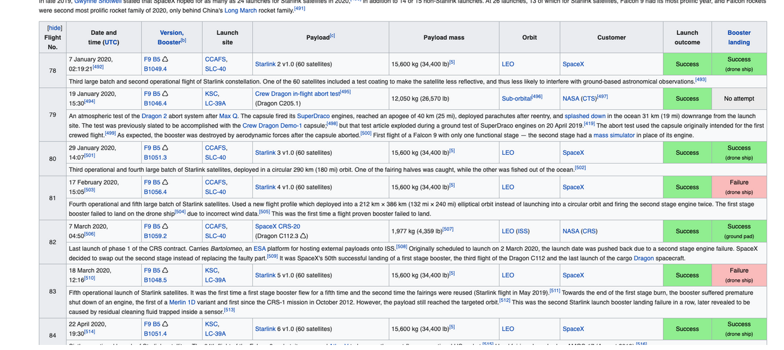
Data Collection - Scraping
https://github.com/saracavaco/capstone_work/blob/main/jupyter-labs-webscraping.ipynb
Place your flowchart of web scraping here

Slide 10

Data Wrangling
Data wrangling describes a series of processes designed to explore, transform, and validate raw datasets from their messy and complex forms into high-quality data. You can use your wrangled data to produce valuable insights and guide business decisions
https://github.com/saracavaco/capstone_work/blob/main/labs-jupyter-spacex-Data%20wrangling.ipynb

Slide 11
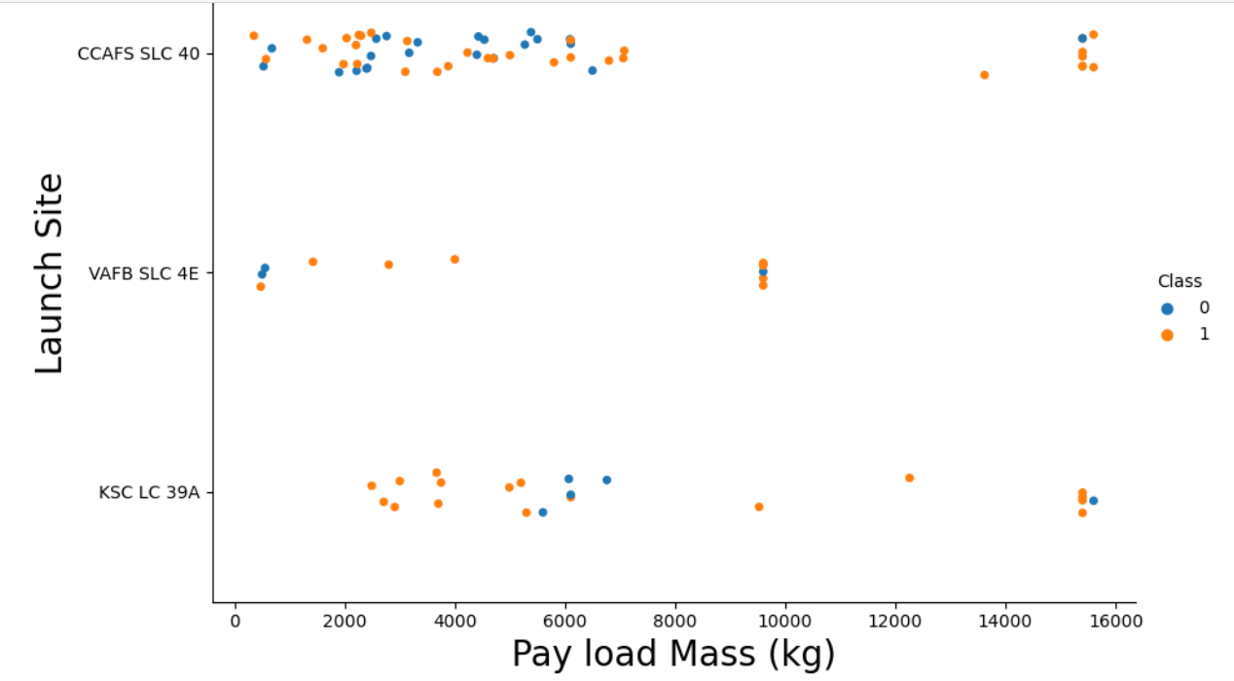
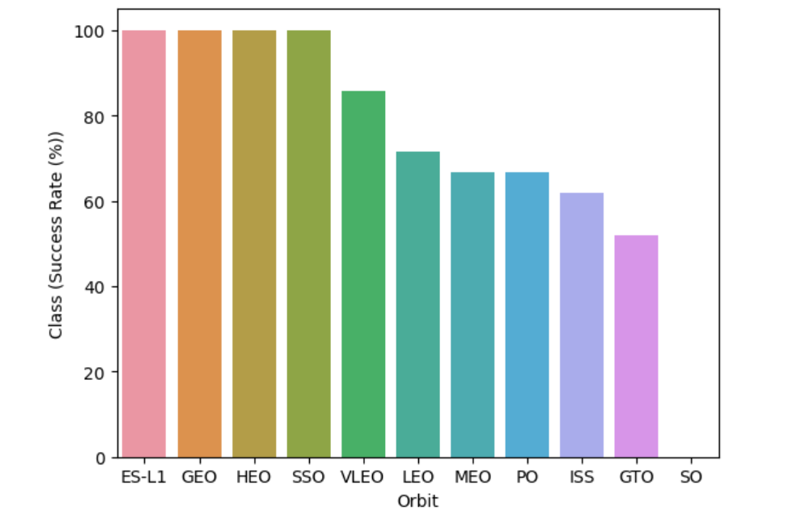
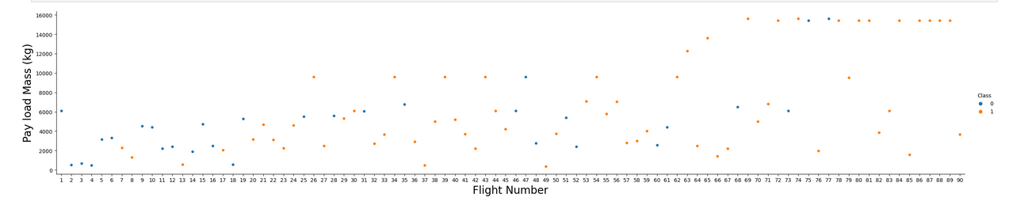
EDA with Data Visualization
Exploratory Data Analysis (EDA) is a process of describing the data by means of statistical and visualization techniques in order to bring important aspects of that data into focus for further analysis.
Scatter plots: It is used to visualize the relationship between two variables. Histograms: It is used to visualize the distribution of a single variable. Box plots: It is used to visualize the distribution of a variable and identify outliers
https://github.com/saracavaco/capstone_work/blob/main/IBM-DS0321EN-SkillsNetwork_labs_module_2_jupyter-labs-eda-dataviz.ipynb.jupyterlite.ipynb

Slide 12
EDA with SQL
EDA With SQL queries performed include
Display the names of the unique launch sites in the space mission
Display 5 records where launch sites begin with the string 'CCA’
Display the total payload mass carried by boosters launched by NASA (CRS)
Display average payload mass carried by booster version F9 v1.1
List the date when the first successful landing outcome in ground pad was achieved.
List the names of the boosters which have success in drone ship and have payload mass greater than 4000 but less than 6000
List the total number of successful and failure mission outcomes
List the names of the booster_versions which have carried the maximum payload mass. Use a subquery
List the records which will display the month names, failure landing_outcomes in drone ship ,booster versions, launch_site for the months in year 2015.
Rank the count of landing outcomes (such as Failure (drone ship) or Success (ground pad)) between the date 2010-06-04 and 2017-03-20, in descending order.
https://github.com/saracavaco/capstone_work/blob/main/jupyter-labs-eda-sql-coursera_sqllite.ipynb

Slide 13
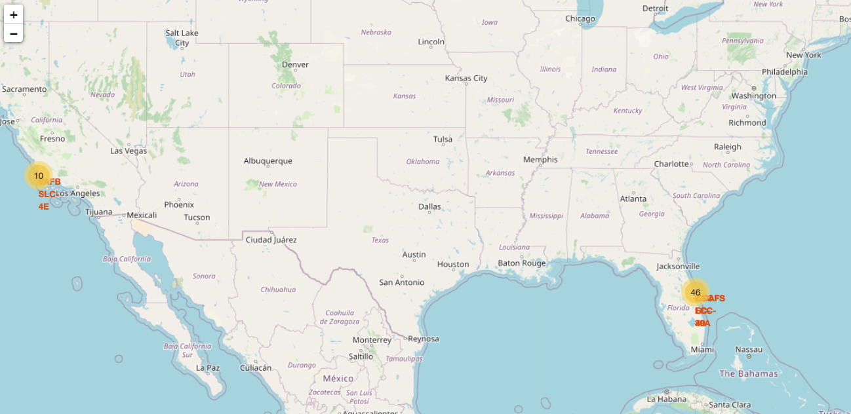
Build an Interactive Map with Folium
Map markers have been added to the map to aim to find the best location to build a launch site
https://github.com/saracavaco/capstone_work/blob/main/IBM-DS0321EN-SkillsNetwork_labs_module_3_lab_jupyter_launch_site_location.jupyterlite.ipynb

Slide 14
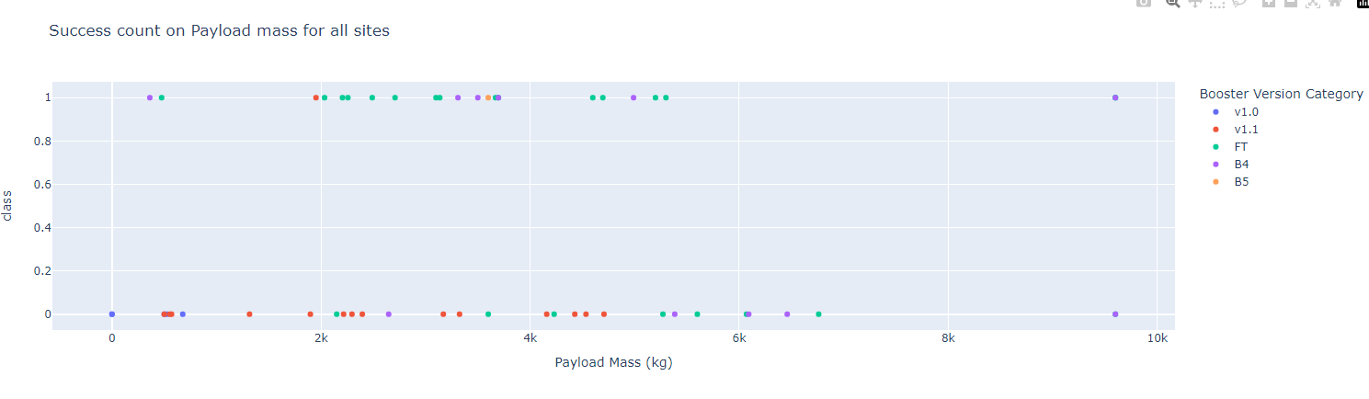
Build a Dashboard with Plotly Dash
In this lab, I have built a Plotly Dash application for users to perform interactive visual analytics on SpaceX launch data in real-time.
This dashboard application contains input components such as a dropdown list and a range slider to interact with a pie chart and a scatter point chart.

Slide 15
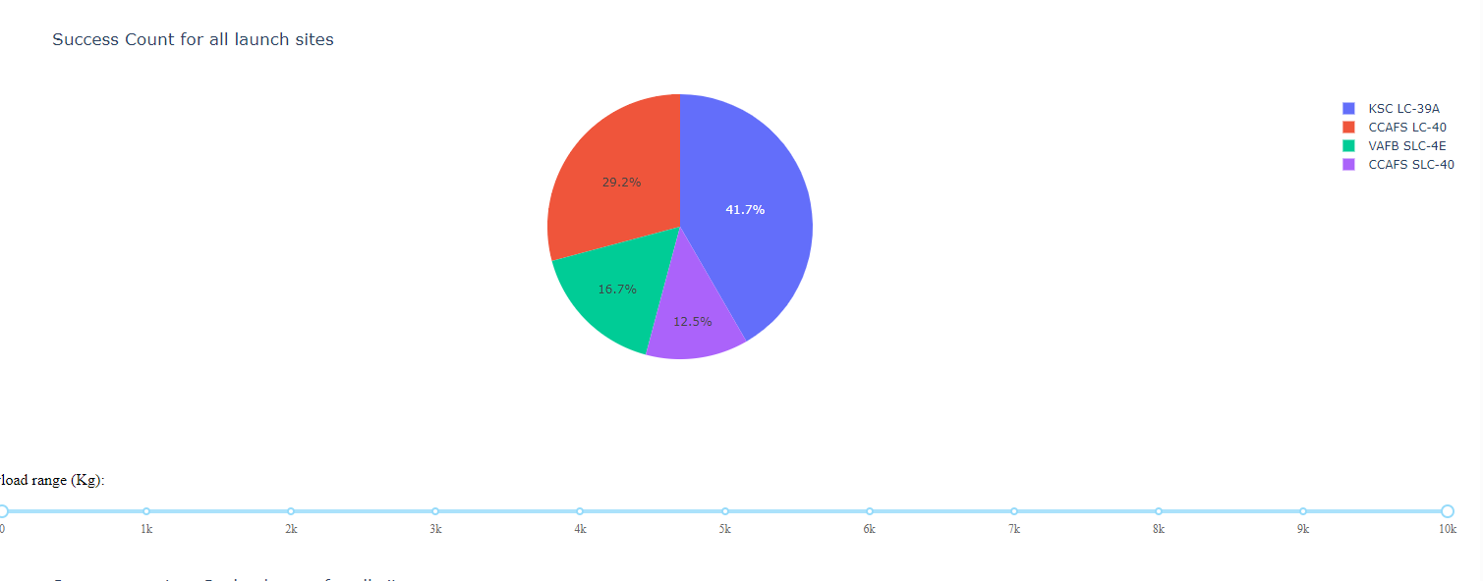
Build a Dashboard with Plotly Dash
https://github.com/saracavaco/capstone_work/blob/main/project.py

Slide 16
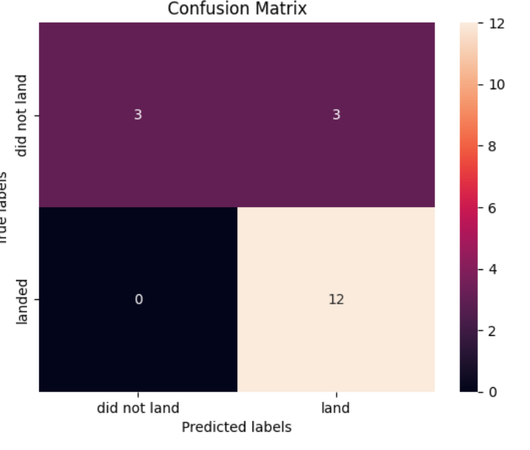
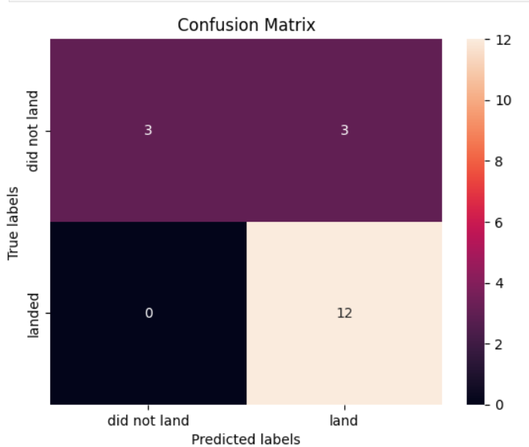
Predictive Analysis (Classification)
This analysis was developed in four stages:
Data Preparation
Model preparation
Model evaluation
Model comparation
https://github.com/saracavaco/capstone_work/blob/main/IBM-DS0321EN-SkillsNetwork_labs_module_4_SpaceX_Machine_Learning_Prediction_Part_5.jupyterlite.ipynb

Slide 17
Results
Exploratory data analysis results
Interactive analytics demo in screenshots
Predictive analysis results

Slide 18

Section 2

Slide 19
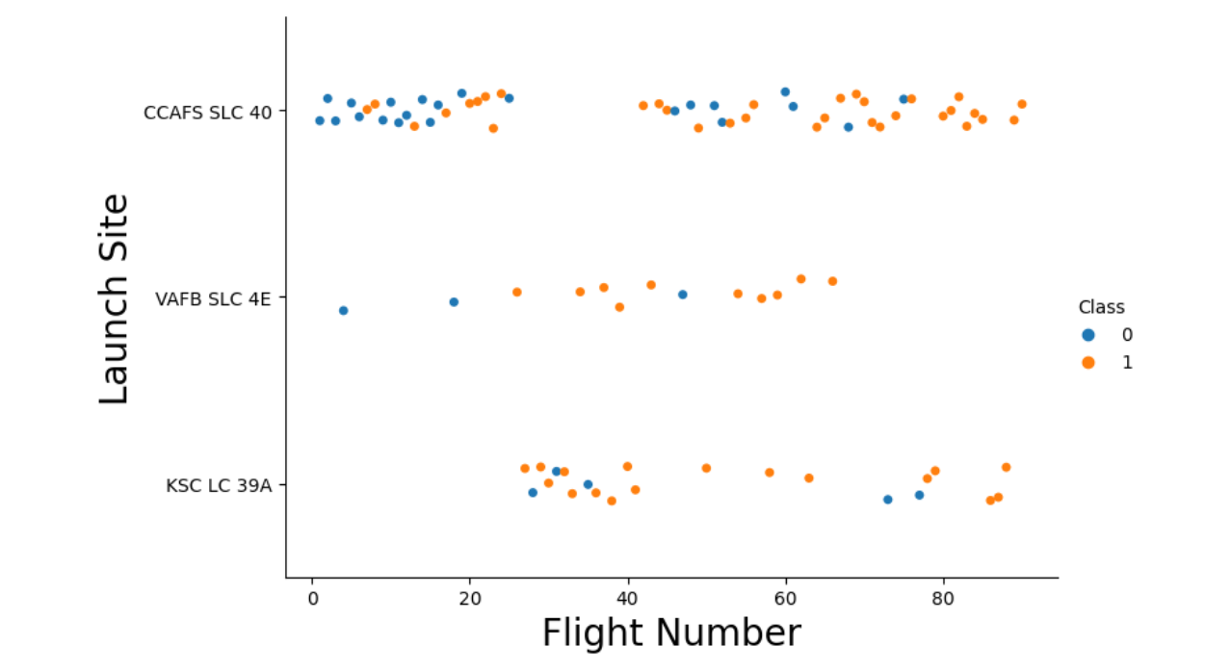
Flight Number vs. Launch Site
As the flight number increases in each of the 3 launch sites, so does the success rate. For instance, the success rate for the VAFB SLC 4E launch site is 100% after the Flight number 50. Both KSC LC 39A and CCAFS SLC 40 have a 100% success rates after 80th flight.

Slide 20
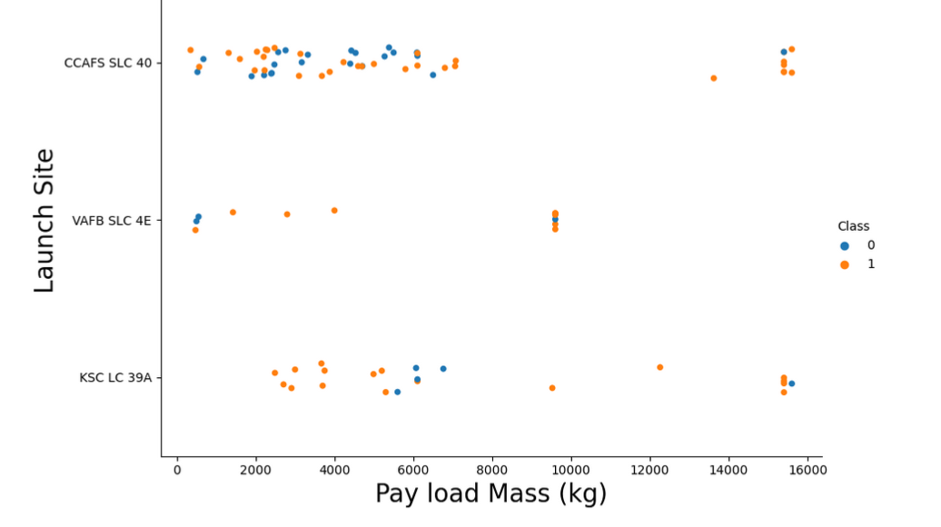
Payload vs. Launch Site
We also want to observe if there is any relationship between launch sites and their payload mass.
We can observe Payload Vs. Launch Site scatter point chart we will find that for the VAFB-SLC launchsite there are no rockets launched for heavypayload mass(greater than 10000).

Slide 21
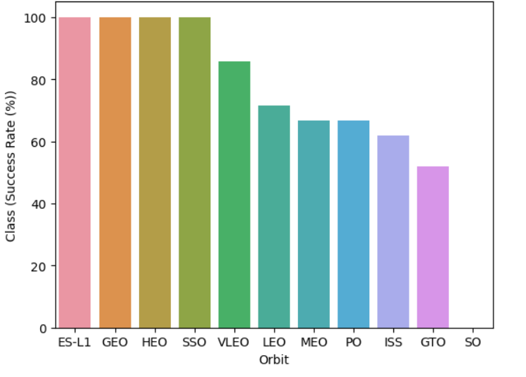
Success Rate vs. Orbit Type
Orbits ES-L1, GEO, HEO & SSO have the highest success rates at 100%, with SO orbit having the lowest success rate at ~50%. Orbit SO has 0% success rate.

Slide 22
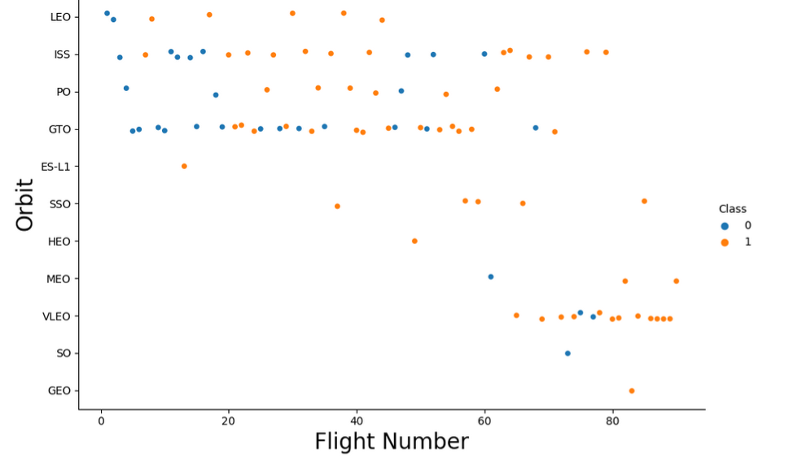
Flight Number vs. Orbit Type
The LEO orbit the Success appears related to the number of flights; on the other hand, there seems to be no relationship between flight number when in GTO orbit.

Slide 23
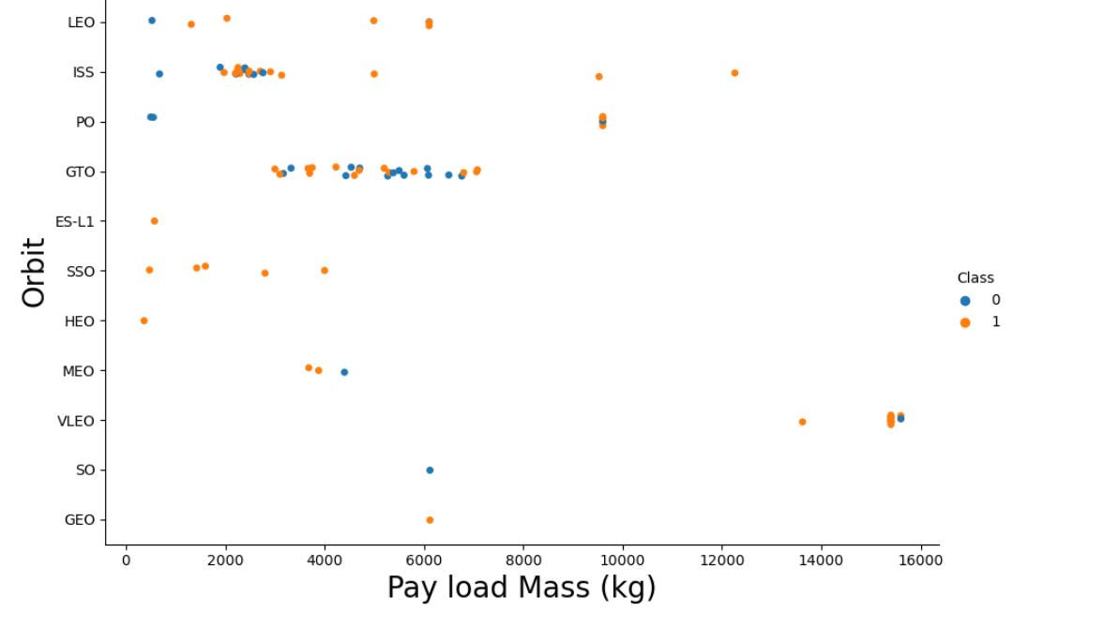
Payload vs. Orbit Type
With heavy payloads the successful landing or positive landing rate are more for Polar,LEO and ISS.
However for GTO we cannot distinguish this well as both positive landing rate and negative landing(unsuccessful mission) are both there here.

Slide 24
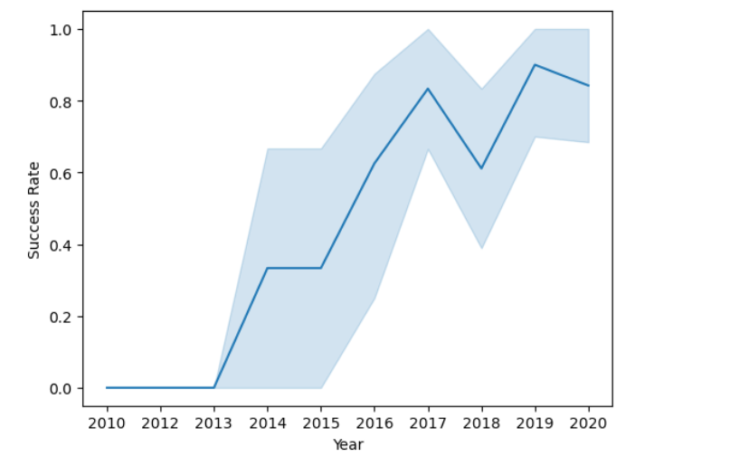
Launch Success Yearly Trend
We can observe that the success rate since 2013 kept increasing till 2020

Slide 25
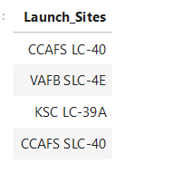
All Launch Site Names
%sql SELECT DISTINCT LAUNCH_SITE as "Launch_Sites" FROM SPACEXTBL;

Slide 26
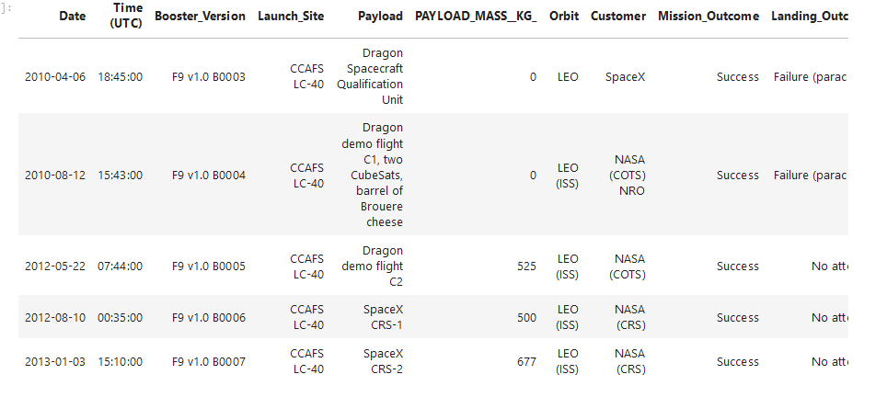
Launch Site Names Begin with 'CCA'
%sql SELECT * FROM 'SPACEXTBL' WHERE Launch_Site LIKE 'CCA%' LIMIT 5;

Slide 27
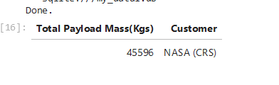
Total Payload Mass
%sql SELECT SUM(PAYLOAD_MASS__KG_) as "Total Payload Mass(Kgs)",
Customer FROM 'SPACEXTBL' WHERE Customer = 'NASA (CRS)';

Slide 28
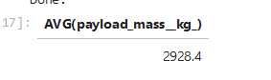
Average Payload Mass by F9 v1.1
%sql SELECT AVG(payload_mass__kg_) FROM SPACEXTBL WHERE booster_version = 'F9 v1.1';

Slide 29
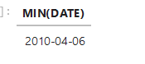
First Successful Ground Landing Date
%sql SELECT MIN(DATE) FROM SPACEXTBL WHERE mission_outcome = 'Success';

Slide 30
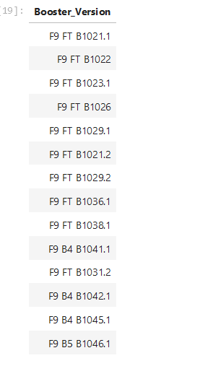
Successful Drone Ship Landing with Payload between 4000 and 6000
%%sql SELECT Booster_Version FROM SPACEXTBL WHERE Landing_Outcome = 'Success (drone ship)' AND 4000 < PAYLOAD_MASS__KG_ < 6000;

Slide 31
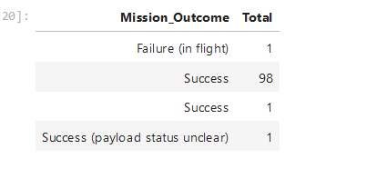
Total Number of Successful and Failure Mission Outcomes
%sql SELECT "Mission_Outcome", COUNT("Mission_Outcome") as Total FROM SPACEXTBL GROUP BY "Mission_Outcome";

Slide 32
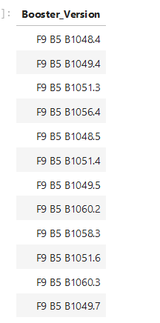
Boosters Carried Maximum Payload
%%sql SELECT DISTINCT BOOSTER_VERSION FROM SPACEXTBL WHERE PAYLOAD_MASS__KG_ = ( SELECT MAX(PAYLOAD_MASS__KG_) FROM SPACEXTBL);

Slide 33
2015 Launch Records
the boosters ['F9 v1.1 B1012', 'F9 v1.1 B1015', 'F9 v1.1 B1017', 'F9 FT B1020', 'F9 FT B1024'] have failed to land with drone ships in 2015
dates=[] for date in df["Date"]: if date[6:10] == "2015": dates.append(date) df_2015=df[df["Date"].isin(dates)] df_2015=df[(df["Landing_Outcome"]=='Failure (drone ship)')] failed_boosters=df_2015["Booster_Version"].to_list()
(f"the boosters \n {failed_boosters} \n have failed to land with drone ships in 2015")

Slide 34
Rank Landing Outcomes Between 2010-06-04 and 2017-03-20
lower_date=df[df["Date"]=="04-06-2010"] higher_date=df[df["Date"]=="16-03-2017"] df_timed=df.iloc[0:31,] df_timed['Landing_Outcome'].value_counts(ascending=False)
No attempt 10
Failure (drone ship) 5
Success (drone ship) 5 Controlled (ocean) 3
Success (ground pad) 3
Failure (parachute) 2 Uncontrolled (ocean) 2 Precluded (drone ship) 1
Name: Landing_Outcome, dtype: int64

Slide 35

Section 3

Slide 36
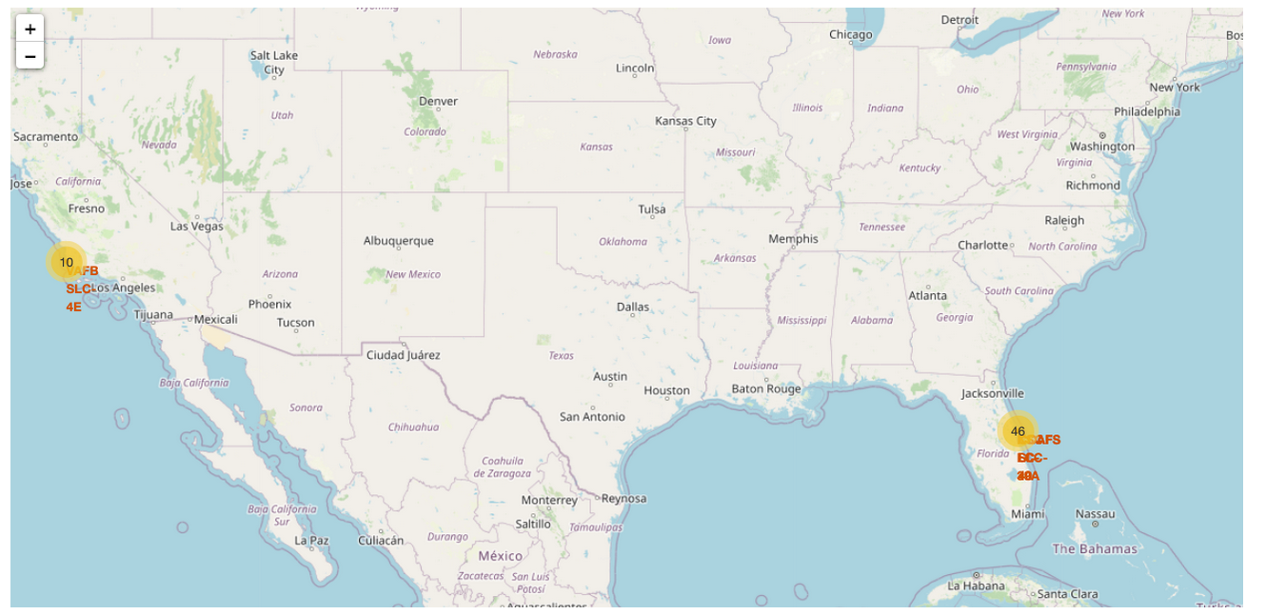
All launch sites marked on the maps

Slide 37
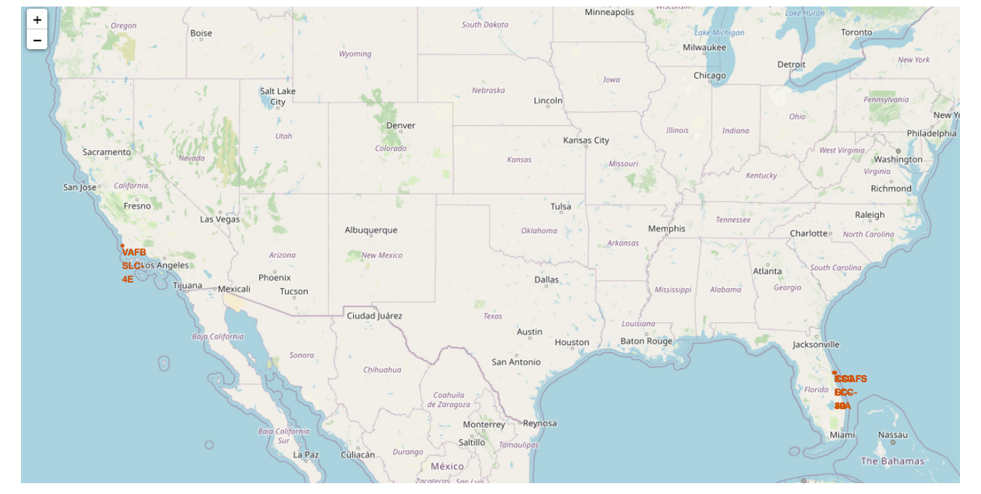
<map with marked launch sites >

Slide 38
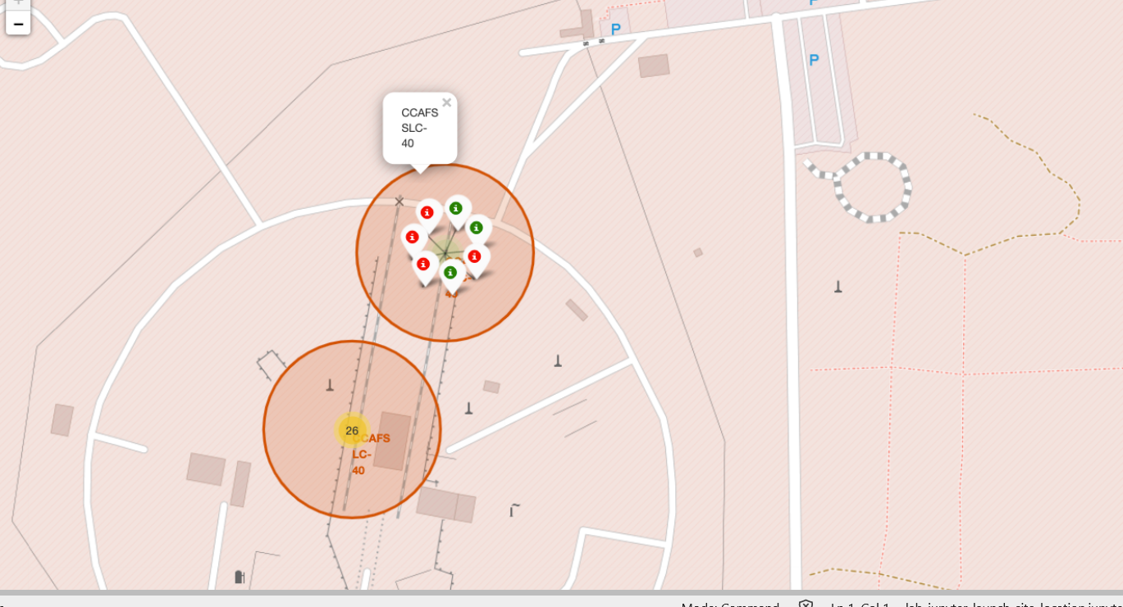
<color-labeled markers in marker clusters>

Slide 39

Section 4

Slide 40
<Count for all the launch sites>
Replace <Dashboard screenshot 1> title with an appropriate title
Show the screenshot of launch success count for all sites, in a piechart
Explain the important elements and findings on the screenshot

Slide 41
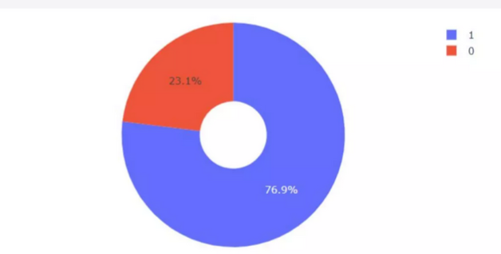
<Success Rate by Launch by Site>

Slide 42
<Payload mass for all sites>

Slide 43

Section 5

Slide 44
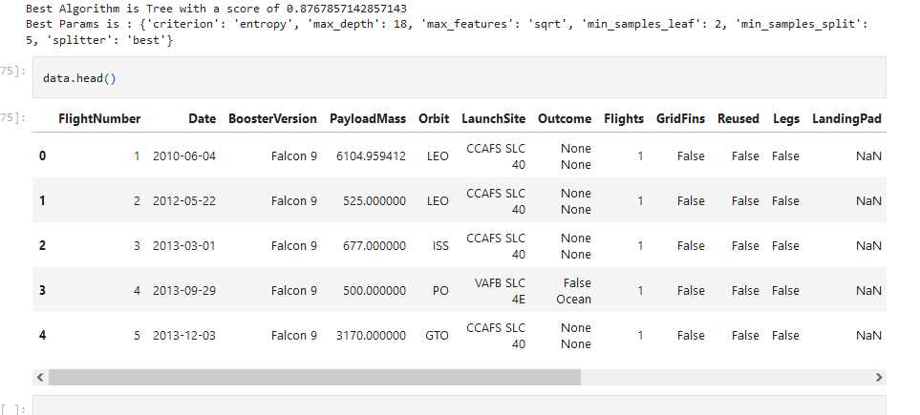
Classification Accuracy

Slide 45
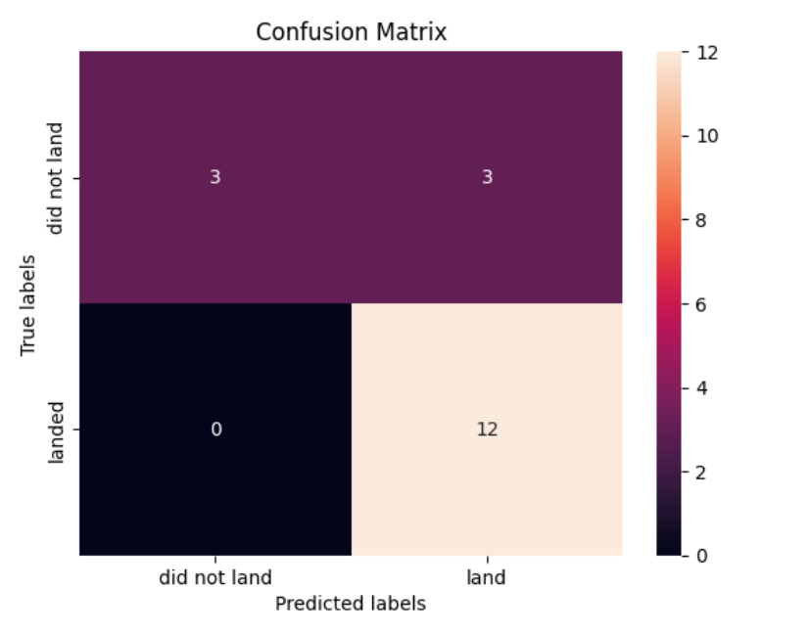
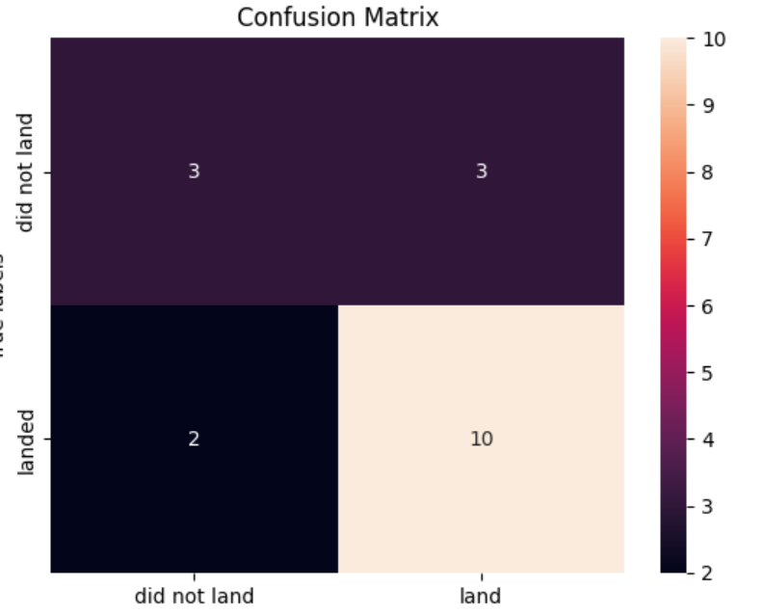
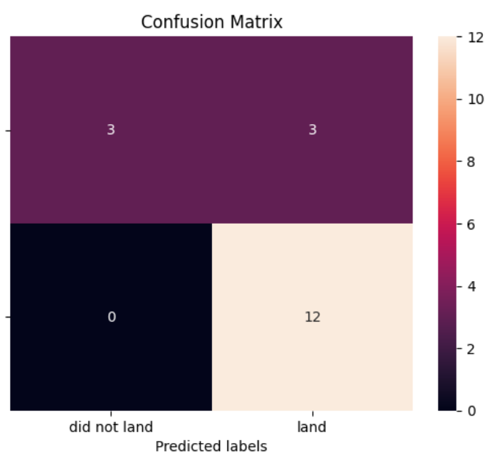
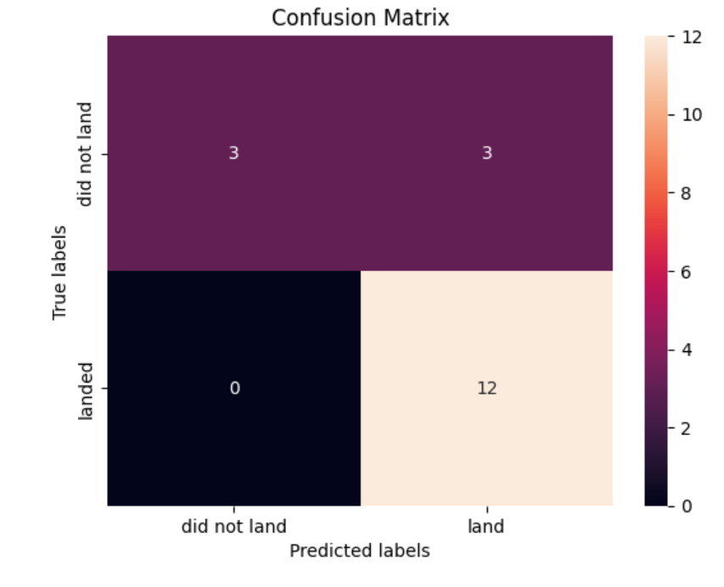
Confusion Matrix

Slide 46
Conclusions
Low weighted payloads perform better than heavier payloads.
The success rate for Space X launches increases along the years, the success rates is increasing along the years.
KSC LC 39 A is the most successful launch
Orbits GEO, HEO, SSO, ES L1 have the success rate
The best models to predict the accuracy of this dataset are SVM, KNN and Logistic Regression.

Slide 47


